Slide 1
Density-independent population growth
Learning goals
Read p1-8 of Vandermeer and Goldberg 2013: Population Ecology - be able to solve all the Exercises.
Be able to calculate the future population size at any time, t.
Be able to calculate the time, t, when the population size is a specific value.
Be able to sketch a graphs, and know how λ affects increases/decreases in population size.
Know how to estimate parameters from data (Protection Island exercise).
Know the assumptions of density-independent population growth.
Be able to give an example of a population that might undergo density-independent population growth
Be able to identify/know the difference between discrete time and continuous time formulations of density-independent population growth formulations and assumptions.
Notes:
Also work of Lecture 2 notes in notebook

Slide 2
General formula for future population size: no immigration/emigration
Variables
N_{t+1} : popn size next year (number)
N_{t}: popn size this year (number)
t: time in years (or the number of years since starting the study)
births: number of births each year that survive to next year
deaths: number of deaths each year

Slide 3
Geometric growth (density-independent)
N_{t+1} : popn size next year (number)
N_{t}: popn size this year (number)
b: per capita number of surviving births each year (unitless)
d: fraction of popn that dies each year (unitless)
bN_{t}: Number of surviving births this year (number)
dN_{t}: Number of deaths this year (number)
Notes:
Emphasize agreement of units on both sides of equation.

Slide 4
Geometric growth rate, λ
Variables
N_{t+1} : popn size next year (number, N_{t+1} ≥0)
N_{t}: Popn size this year (number, N_{t}≥0)
Parameters
b: per capita number of surviving births each year (unitless; b≥0)
d: fraction of popn that dies each year (unitless; 0≤d≤1)
λ = 1+b-d: geometric rate of increase/decrease (unitless; λ≥0)

Slide 5
Geometric growth is density-independent population growth (discrete time)
population size, N_{t}

Slide 6
What are examples of species whose population sizes increase/decrease geometrically/exponentially?
i.e. density-independent population growth
Note: for these examples the time step may not be 1 year

Slide 7
Aside: Discrete vs. continuous time
Discrete time
Offspring take 1 time step to be reproductive
Births occur during a short window of the time step
Density-independent growth is referred to as ‘geometric growth’ (except some, including Vandermeer and Gordon, use ‘exponential growth’ )
Continuous time
Offspring can immediately reproduce
Births occur at any time (not pulse reproduction)
Density-independent growth is referred to as ‘exponential growth’

Slide 8
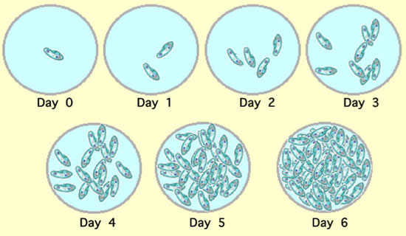
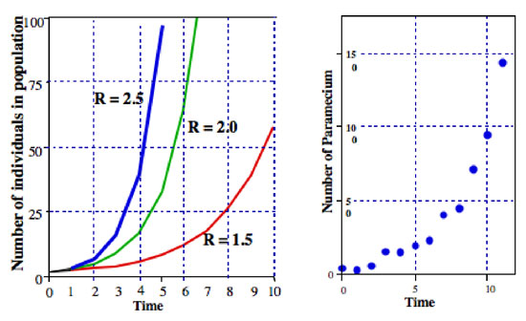
The first 6-10 days of Paramecium growth in a lab culture
Image credits: Vandermeer 2010. How poulations grow: The exponential and logistic equations. Nature Education Knowledge Project
λ=2.5
λ=2.0
λ=1.5
Continuous time

Slide 9
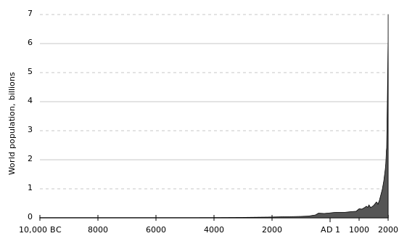

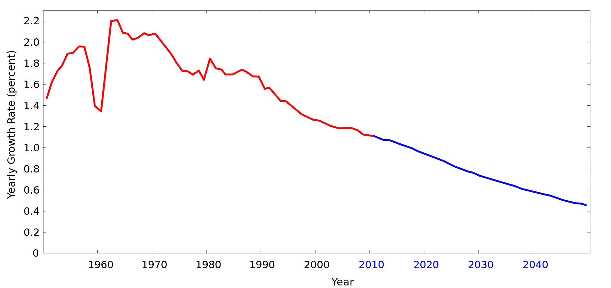
Humans
r x 100%
Continuous time
Image credit: Conscious

Slide 10
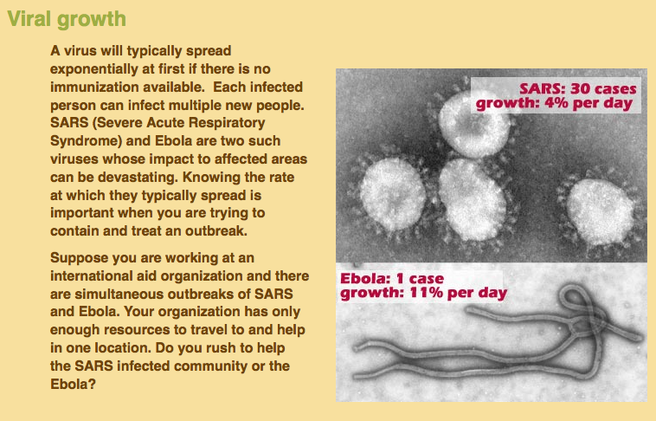
The number of people infected with a disease at the beginning of an outbreak when no vaccine is available
Math Bench: Biology Modules
Continuous time

Slide 11
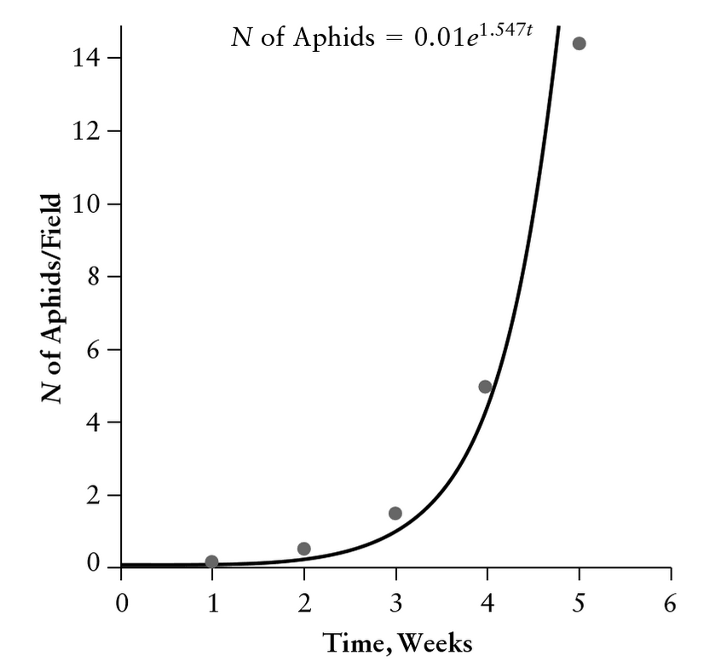
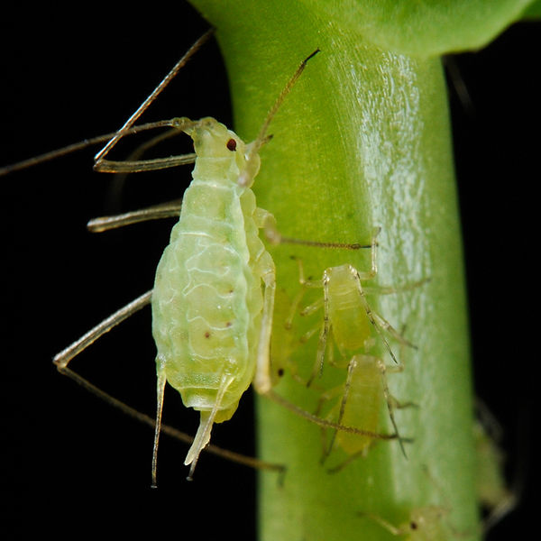
Aphid growth during the first 6 weeks
Discrete time?
Photo credits: Shipher Wu and Gee-way Lin
Vandermeer, JH and Goldberg, DE. 2013. Population Ecology: First Principles (2nd Edition).

Slide 12
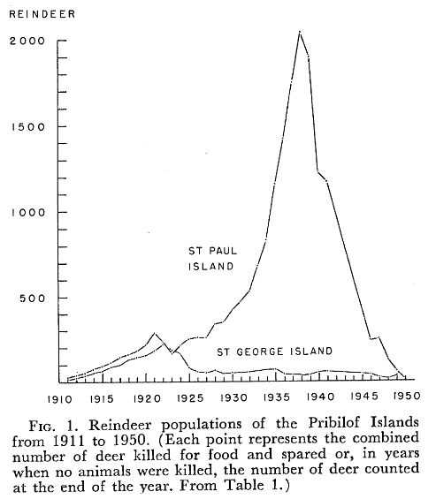
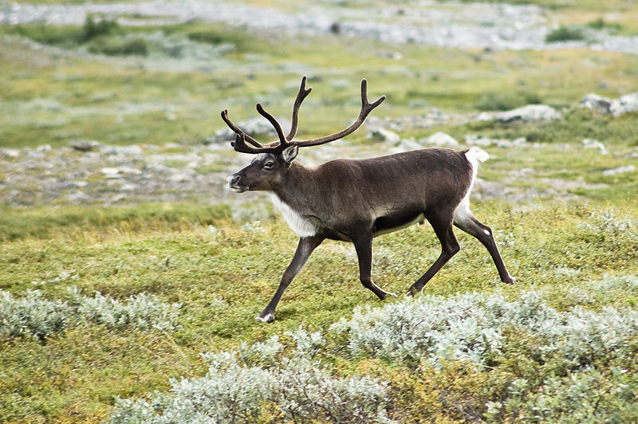
Reindeer growth on islands prior to lichen overgrazing
Photo credit: Alexandre Buisse
Scheffer, VB. 1951. The rise and fall of a reindeer herd. The Scientific Monthly.
Discrete time

Slide 13
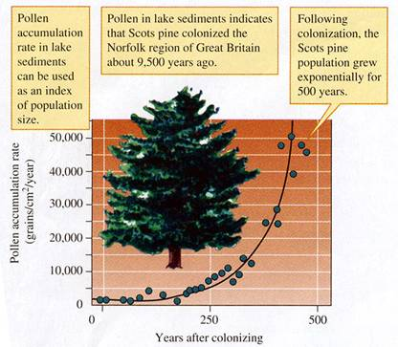
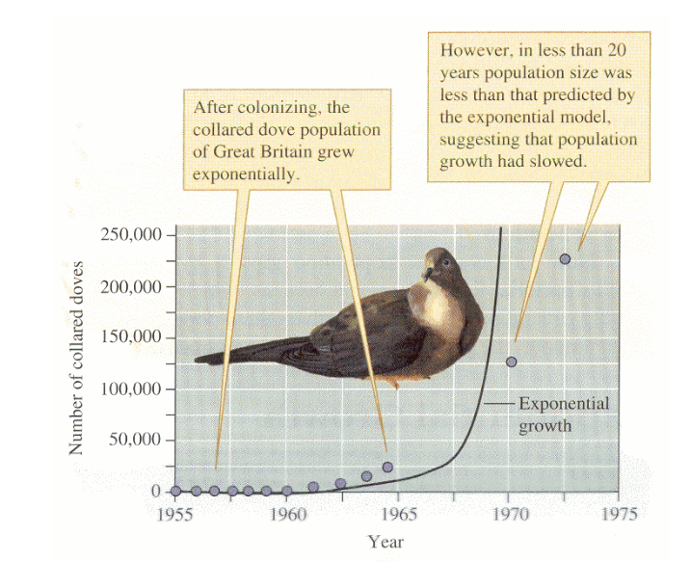
Scots pine colonizing in Britain
Collared dove in Britain
Discrete time
Discrete time
Molles, MC. 2012. Ecology: concepts and applications.

Slide 14
There are many examples of density-independent population growth in nature, but
they apply only to the initial phase of population growth
several examples are from islands were populations are protected form predators

